Slide 1
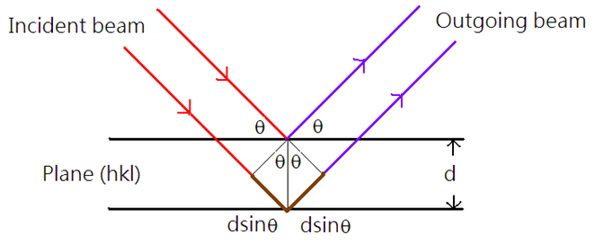
VII. Bragg’s law
7-1. Bragg’s law
When the total path difference
equals to , diffraction occurs.
n: order of
reflection
Bragg’s Law:

Slide 2
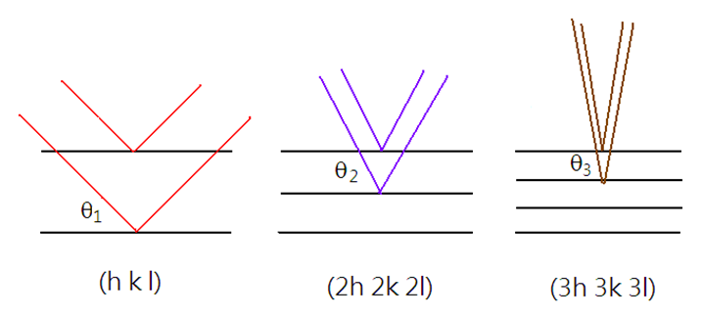
The Bragg’s equation can be rewritten as
Therefore,

Slide 3
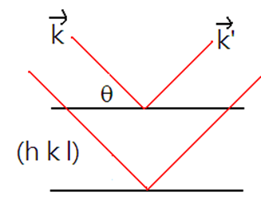
7-2. Ewald sphere construction
: the wave number of the incident beam
: the wave number of the outgoing beam
Define

Slide 4
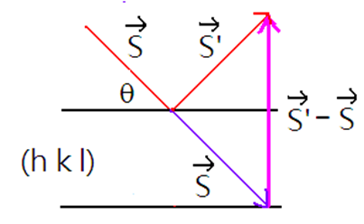
Proof:
(i)

Slide 5
(ii)
is parallel to (h, k, l) plane normal
Therefore,

Slide 6
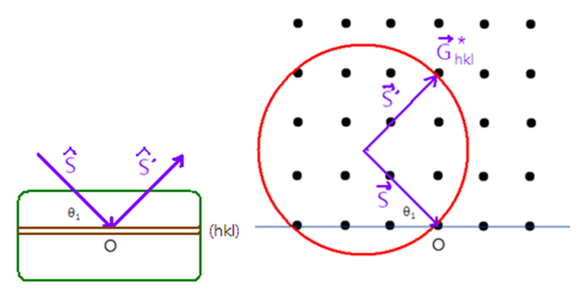
7-3. Ewald Sphere
The reciprocal lattice is derived from the
crystal structure
Diffraction occurs at

Slide 7
Ewald Sphere
Diffraction condition
1/λ

